Slide 1

Magnetic model systems
Goal: Using magnetic model systems to study interaction phenomena
Let’s start with a reminder and a word of caution:
If, without further thought, we use our standard approach
Hamiltonian
Eigenenergies
Contradiction
for magnetic
systems
canonical partition function Z
Helmholtz free energy, F
We know from thermodynamics that Gibbs free energy:
G=G(T,H)
and
Next we show:
rather than F, which is very tempting to assume, in fact confused
frequently in the literature but nevertheless wrong !!!
Note: F=F(T,M)
Helmholtz free energy is a function of T and M

Slide 2
Let’s consider for simplicity N independent Ising spins σ_{i}=±1 in a magnetic field H
The magnetic energy of the N particle system reads
where the microstate α depends on (σ_{1,} σ_{2, …,} σ_{N})
and m₀ is the magnitude of the magnetic moment of a spin
with
From this we expect

Slide 3
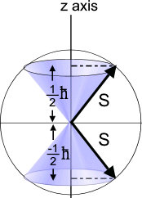
Paramagnetism
Note, we will use the result of the interaction free paramagentism to find an approximate solution for the 3d interacting case
Rather than restricting to the Ising case where the spins can only point up or down
relative to the field direction
we consider the general case of N independent atoms
with total angular momentum quantum number J
m_{J}=+J=+5/2
+3/2
+1/2
-1/2
-3/2
m_{J}=-J=-5/2
Energy of microstate α
here example for J=5/2
where now

Slide 4
To streamline the notation we define:

Slide 5
Since the thermodynamics is obtained from derivatives of G with respect to H and T let’s explore
Where the Brillouin function B_{J} is therefore reads:

Slide 6
Discussion of the Brillouin function
1
J=1/2
with

Slide 7
2
X<<1
with
Note, this expansion is not completely trivial.
Expand each exponential up to 3rd order, factor out the essential singular term 1/y and expand the remaining factor in a Taylor series up to linear order.
X<<1
3
X>>1
X<<1

Slide 8
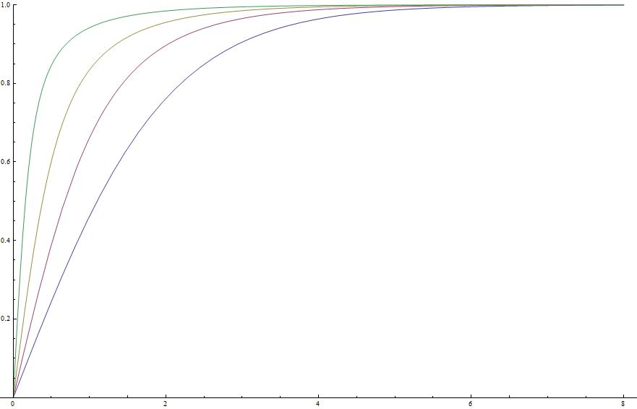
J=10
J=7/2
J=3/2
J=1/2
4
J→∞
J→∞
J→∞
Langevin function
negligible except
for x→0
X=g μ_{B}μ₀H/k_{B}T

Slide 9
Average magnetic moment <m> per particle
and
In the limit of H→0 we recall
Curie law

Slide 10
Entropy per particle s=S/N
In the limit of H→0
0
with
Example for J=1/2
ln2
multiplicity

